Slide 1

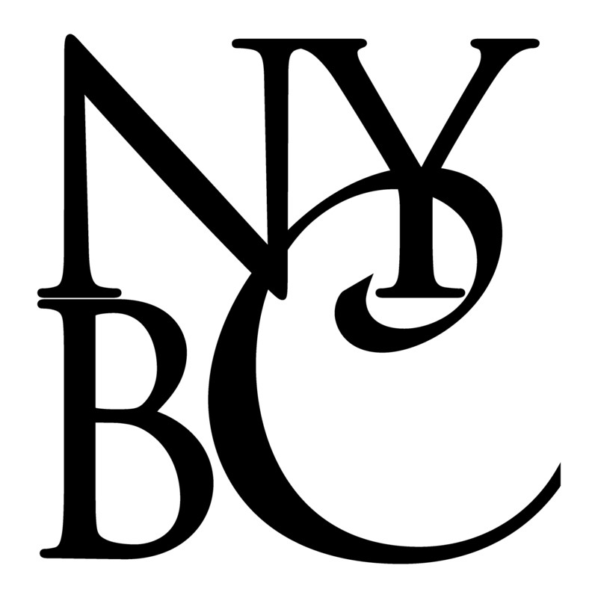
MTA Bridges and Tunnels
New York Building Congress
November 13, 2014

Slide 2
Overview
Introduction
2010-2014 Capital Program
Sandy Restoration/ Mitigation Program
2015-2019 Capital Program
Operating Program
Small Business Mentoring Program
New Initiatives & Directions
Upcoming Opportunities
Q/A

Slide 3
2010-2014 Capital Program:
Current Status
Out of $2.078B, as of end of October, 2014, $1.33 Billion has been committed. Approximately 90% of the commitments are anticipated to be awarded before the end of 2014 including the following:
  BB28/BB28S/BB54 – Restoration of Hugh C. L. Tunnel & Repair/ Replacement of Brooklyn Plaza Structural Slab
  RK65A – Reconstruction of Bronx Toll Plaza
  RK23A – Reconstruction and Rehabilitation of the Manhattan Approach Ramps
  HH88A – Reconstruction of Upper and Lower Plaza and Southbound Approach
  RK76 – Miscellaneous Structural Repair
  TN-52 – Miscellaneous Structural Rehabilitation
  HH-88A – ORT Gantry Installation
Anticipate the following awards in 2015:
  QM40/QM40S/QM18 – Restoration of Queens Midtown Tunnel
  CB99S/ MP03/MP-03S (Design -Build)– Replace CBB Mech. & Elect Equip – S. Abutment / S. Bldg and Rehab MPB Mech. and Elect Equip – N. Abutment

Slide 4
Sandy Programs
A $778 million Capital Amendment approved by MTA Board in December, 2012 for Restoration work at the Hugh L. Carey and Queens Midtown Tunnels, and the bridges damaged by Sandy.
$700 million will address damage to the tunnels
$78 million will address damage to bridges and other assets
Sandy Program divided in two categories –
Sandy Restoration
  BB-28/28S/54 low bid $283M. Anticipate award by end of November (includes some mitigation work)
  QM-40/40S/18 – Anticipate award in first quarter 2015 (Includes some mitigation work)
Sandy Mitigation - See following Slide

Slide 5

Sandy Mitigation Program
Contracting Opportunities
Type of Work under Mitigation Program to be awarded 2015 and beyond:
  Tunnel Perimeter Work
  Extension of Plaza Retaining Wall, Protection of Vulnerable Locations
  Raising Sea-Wall
  Flood Mitigation work at Service Buildings, including flood walls
  Design/Build of Electrical Substation
  Relocation of Revenue Control System
  Standby Emergency Generator
  Elevating bridge plazas, and flood proofing of utilities

Slide 6
Proposed 2015-2019 Capital Program
Distribution By Facility
Distribution By Asset Category
Notes:
As you can see, a significant portion of the capital work in the upcoming years is focused at three long span bridges, the RFK, VNB and TNB.
The majority of the capital program is focused on State of good repair projects dealing with the decks and supporting structures.

Slide 7
Proposed 2015-2019 Capital Program
Eleven projects account for approximately 60% of the 2015-2019 Program total.
Four of the projects are major deck replacement or deck rehabilitation projects
Six of the projects are major structural rehabilitation projects
One project is the construction of a new off Ramp from the RFK to the North Bound Harlem River Drive

Slide 8
Operating Program
Average Operating program spending projected at $70M over the next 5 years.
  Typical Work performed under operating budget includes:
  Paving
  Flag Repairs
  Bridge Preservation
    Bridge Washing
    Spot Painting
    Scupper Cleaning
    Drainage Cleaning
    Joint Cleaning & Replacement
  Work under operating program typically contracted via As-Needed Requirements Contractors and SBMP contractors
Notes:
Our Operating/MM program is to fund all on-going major maintenance, as-needed repair and rehabilitation work, biennial inspection, some painting work, bridge preservation, tunnel inspection program, and other needs.
Work is typically contracted via as-needed requirements contractors and SBMP contractors, however, some work will be combined with capital projects due to coordination/best value considerations

Slide 9
B&T Current SBMP Program Status
Notes:
Goal - $14,500,000, Awarded - $20,885,897 (projected)
B&T is expected to exceed the 5-year SBMP goals by approximately 44%

Slide 10
New Initiatives and Directions
Use of Design-Build:
B&T has completed 12 design-build projects to-date
On-going DB projects include:
  RK-65R2: Training Facility
  VN-87: Substation #1 Rehabilitation
Upcoming Design-build opportunities
  CB-99S: Replace Mech. & Elect Equipments, S. Abutment & S. Bldg.
  MP-03S: Programmable Logic Controller & Mechanical Rehab
  MP-21: Rehab of Rockaway Point Blvd Overpass and Jacob Riis Park Pedestrian Bridge
A significant portion of the 15-19 program will be Design Build projects
Notes:
As you can see, B&T has been embracing the Design-build method when possible. Based on the success of the projects to date,
B&T anticipates expanding its use of design build projects over the upcoming capital program.

Slide 11
New Initiatives and Directions
Enhanced Safety Program:
Strong emphasis on safety (public, contractor, customers) throughout the MTA.
Cultural change from compliance and enforcement driven to a system safety approach.
As-needed Construction, Design, and CM contracts
Use of as-needed construction, design and CM Contracts increasing due to need for greater flexibility and speed in progressing work
Continued focus on meeting WBE/MBE Goals:
WBE/MBE requirements and compliance will be strictly enforced.
Final performance evaluation and future awards will consider past MBE/WBE goal compliance performance.
Notes:
Safety program:
Safety is paramount at B&T. The project must be driven by safety. This requires a cultural change to a system safety approach.
As needed:
Due to the need to react in a timely manner to changing conditions, the Authority has expanded its use of as-needed construction, design and CM contracts.
WBE/MBE
Goals are currently 10 & 10. The goals will be increasing in the near future. It is imperative to make every effort to meet the goals and performance appraisals will reflect this effort.

Slide 12
Opportunities
Upcoming Construction Contracts

Slide 13
Proposed Major Construction Contracts
2015-2019 Program
Facility | Project & Description | Project Budget | Duration (Months) | Planned Award Year
Bronx-Whitestone Bridge | BW-14 Miscellaneous Structural Rehabilitation | $ 78M | 30 | 2015
Henry Hudson Bridge | HH-88B Reconstruction of Toll Plazas and Southbound Approach | $ 92M | 51 | 2016
 | HH-89 Skewback Retrofit | $ 83M | 33 | 2016
Marine Parkway Bridge | MP-16 Miscellaneous Steel Repairs and Zone Painting of the MPB below roadway, spot paint above roadway | $ 82M | 39 | 2015
RFK Bridge | RK-19 / RK-70 Seismic/Wind Retrofit and Structural Rehabilitation / Miscellaneous Structural Repairs | $ 235M | 42 | 2018
 | RK-23C Construction of New HRD Ramp | $ 155M | 30 | 2018
Throgs Neck Bridge | TN-49 Replacement of Grid Decks on Suspended Span and Painting on Suspended Span | $ 360M | 48 | 2017
 | TN-53 Approach Viaducts Seismic Retrofit & Structural Rehab | $ 163M | 36 | 2017
Verrazano Narrows Bridge | VN-34 Main Cable & Suspender Rope Testing Ph I | $ 42M | 38 | 2017
 | VN-84 Replacement of Upper Level Elevated Approach & Anchorage Decks - Ph 1 | $ 132M | 36 | 2018

Slide 14
Proposed Major Operating Projects
2015-2019 Program
Project & Description | Projected Budget | Planned Award Year
GFM-509 Miscellaneous Construction on an As-needed Basis | $ 80M | 2017
GFM-512 Authority-wide Roadway Repairs | $ 34M | 2017
GFM-513 Miscellaneous Authority-wide Painting | $ 2M | 2016

Slide 15
Upcoming Opportunities
An Eye on the Future. Future solicitations – Updated Quarterly covering a running 6-month period.
http://web.mta.info/mta/capital/eotf.htm
Dashboard. 2010-2014 Project schedules and budgets, as well as selected 2005-2009 Project schedules and budgets – Updated Quarterly.
http://web.mta.info/capitaldashboard/CPDHome.html
2015-19 Capital Program
http://web.mta.info/capital/pdf/Board_2015-2019_Capital_Program.pdf

